Slide 1
Pre-Live Session 4
By Ben Goodwin

Slide 2
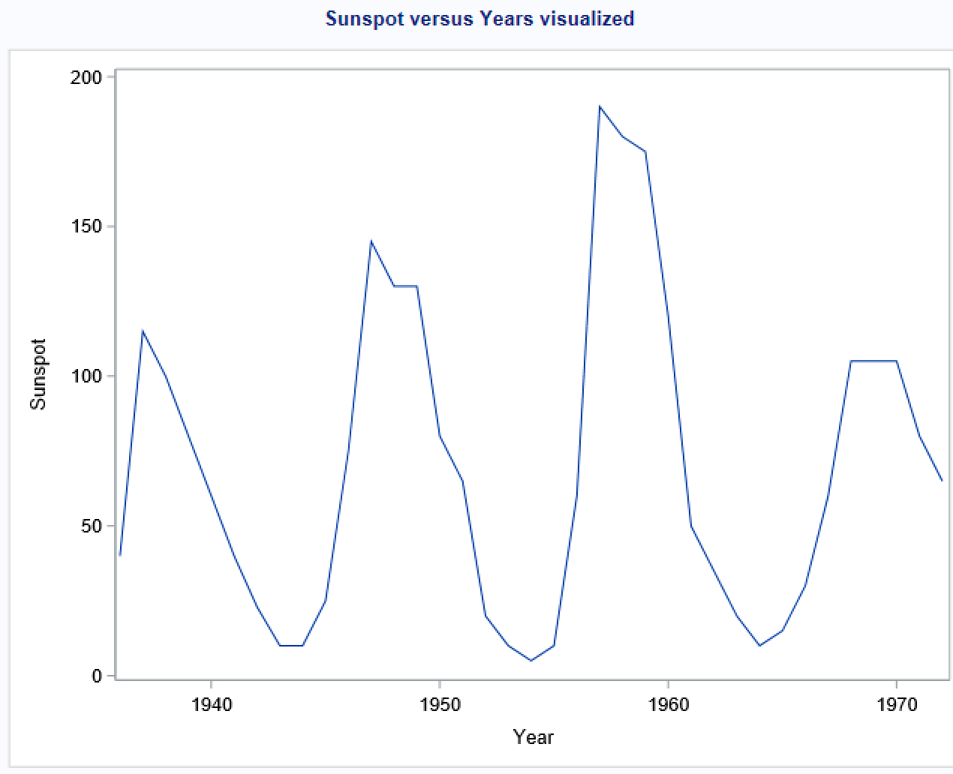
Question 1, Plotting Sunspot versus Years
Positive correlation in these data, large (small) values tend to be followed by larger (smaller) values
Cyclic behavior
I believe this data to be stationary
It seems like the timing of these sunspots is not too predictable.

Slide 3
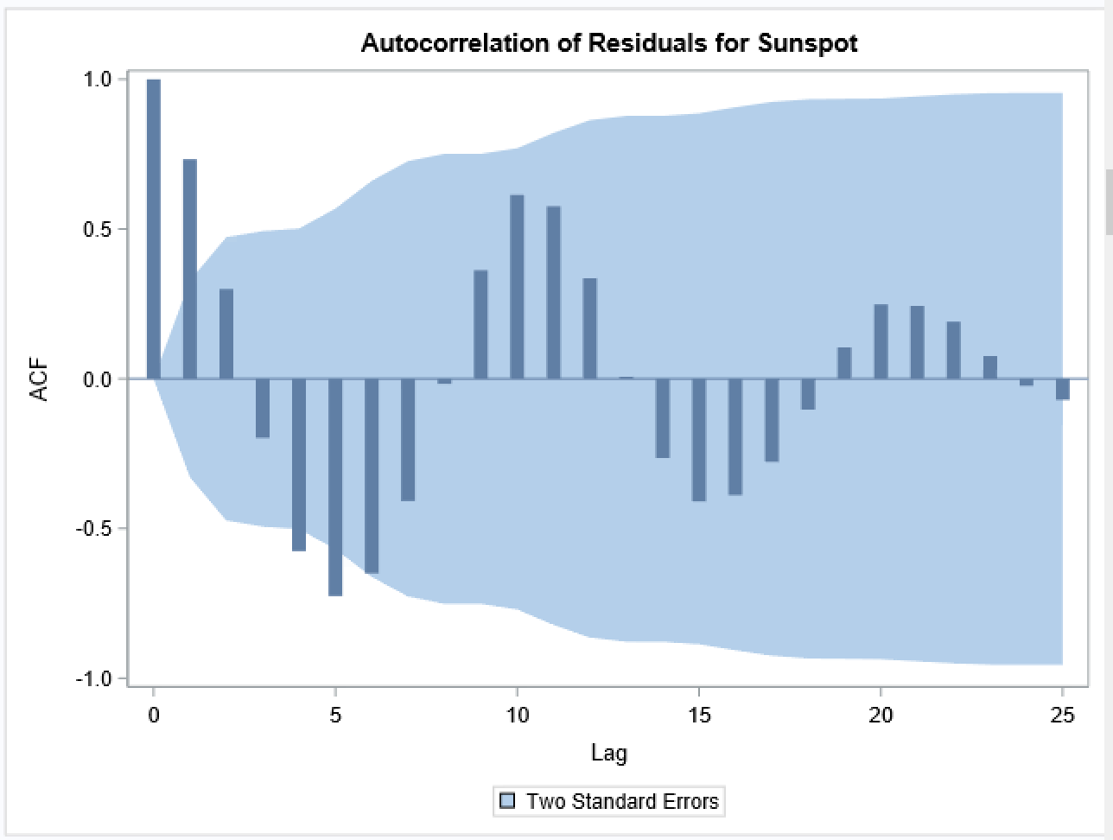
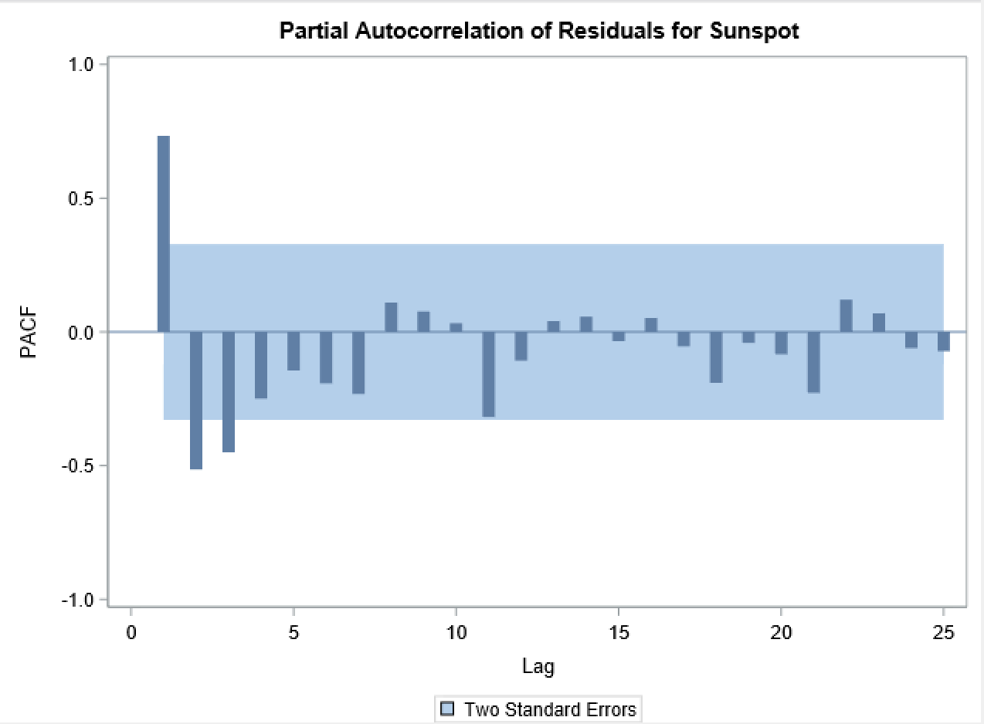
Question 1, ACF and PCF P
AR(1)
ACF should exponentially decrease to 0 as the lag increases, there is evidence of this occurring as the plot progresses
PCF should be equal to 0 beyond the order of the model. The number of non-zero partial autocorrelations gives the order of the AR(1) model
AIC: 373.069

Slide 4
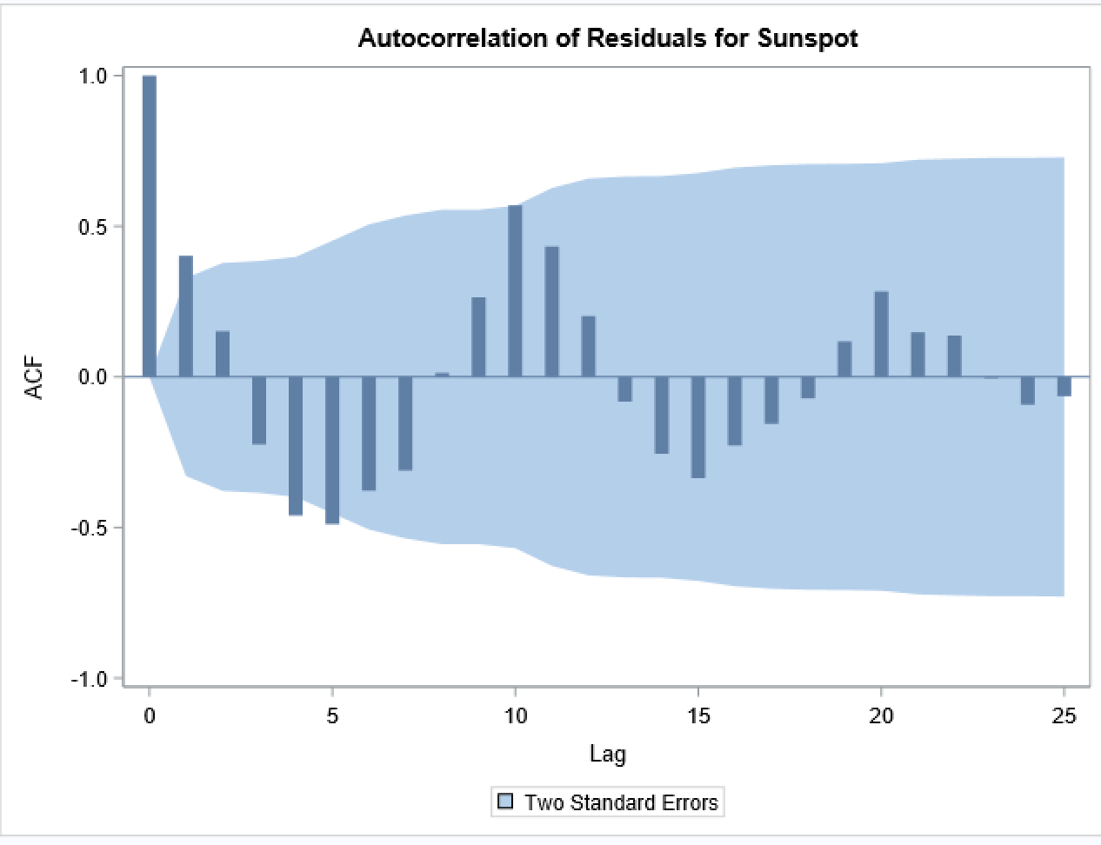
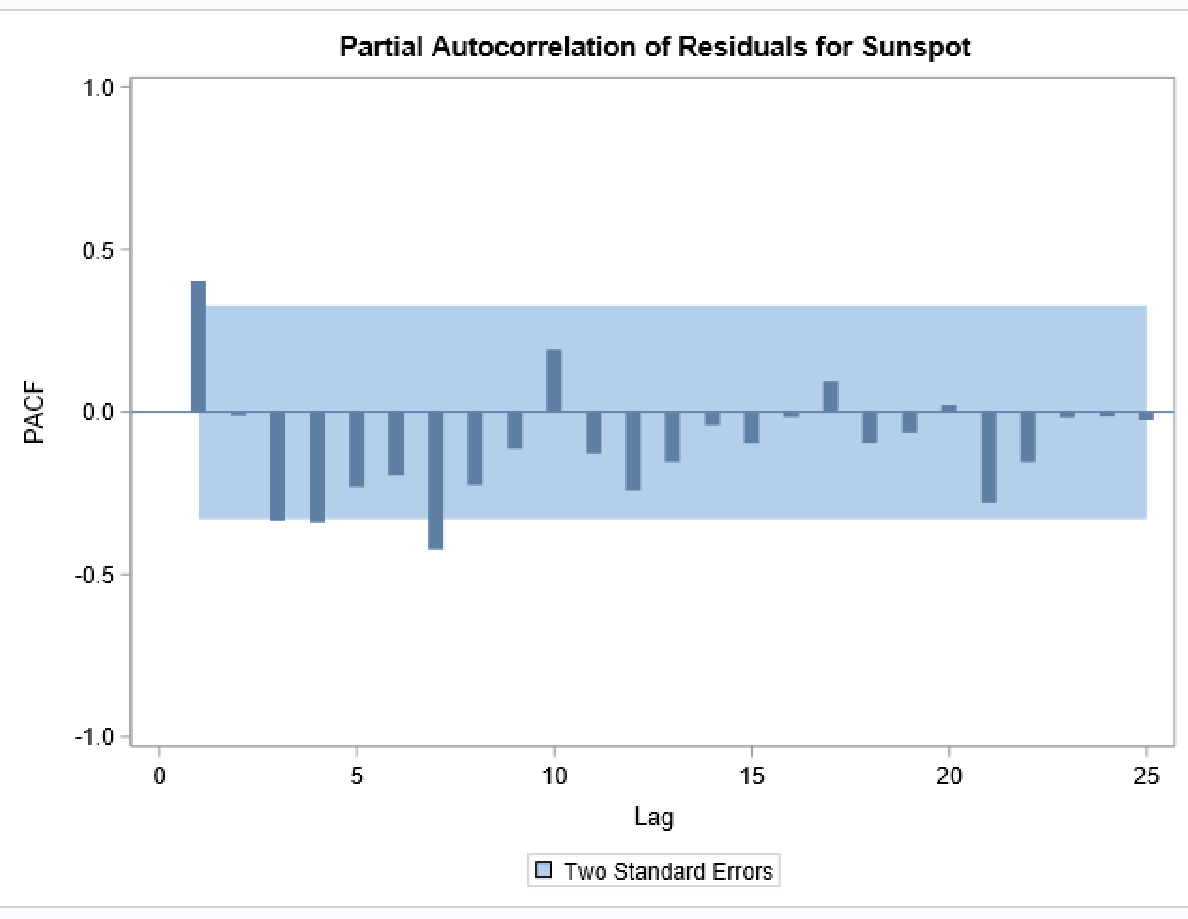
Question 1, Fitting AR(1) ,AR(2), AR(3), and AR(4) Mod
AR(2)
There is evidence of exponential decay-indicates a negative autocorrelation coefficient
In the PCF, this tells us what the order of the model might be
There is a large bar at partial autocorrelation function for lag 1
Tends to indicate this should be an AR(1) model
AIC: 360.309

Slide 5
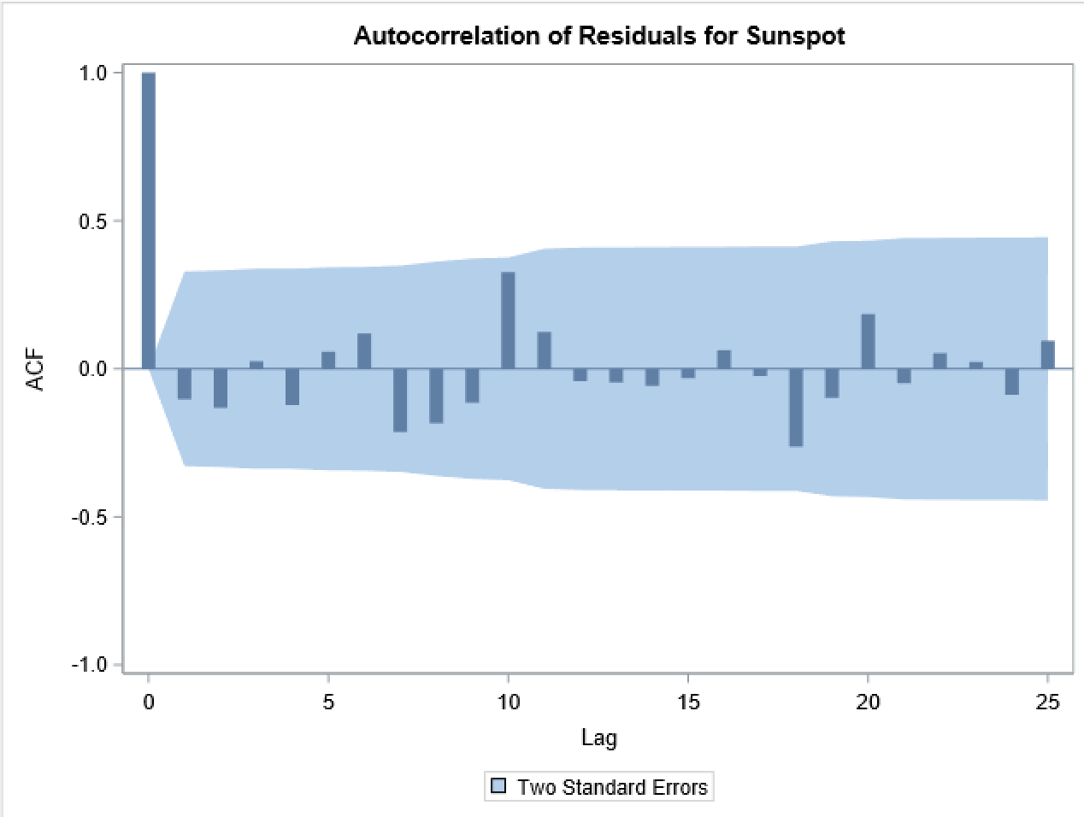
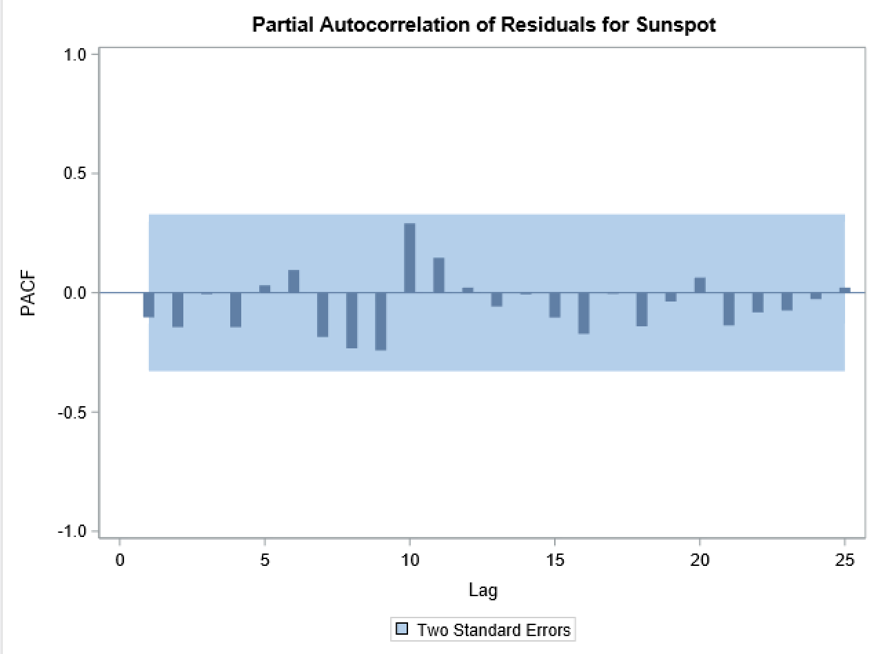
Question 1, Fitting AR(1) ,AR(2), AR(3), and AR(4) Mod
AR(3)
There is evidence of exponential decay-indicates a negative autocorrelation coefficient
In the PCF, this tells us what the order of the model might be
There is a large negative bar at partial autocorrelation function for lag 1
Tends to indicate this should be an AR(1) model
AIC: 355.033

Slide 6
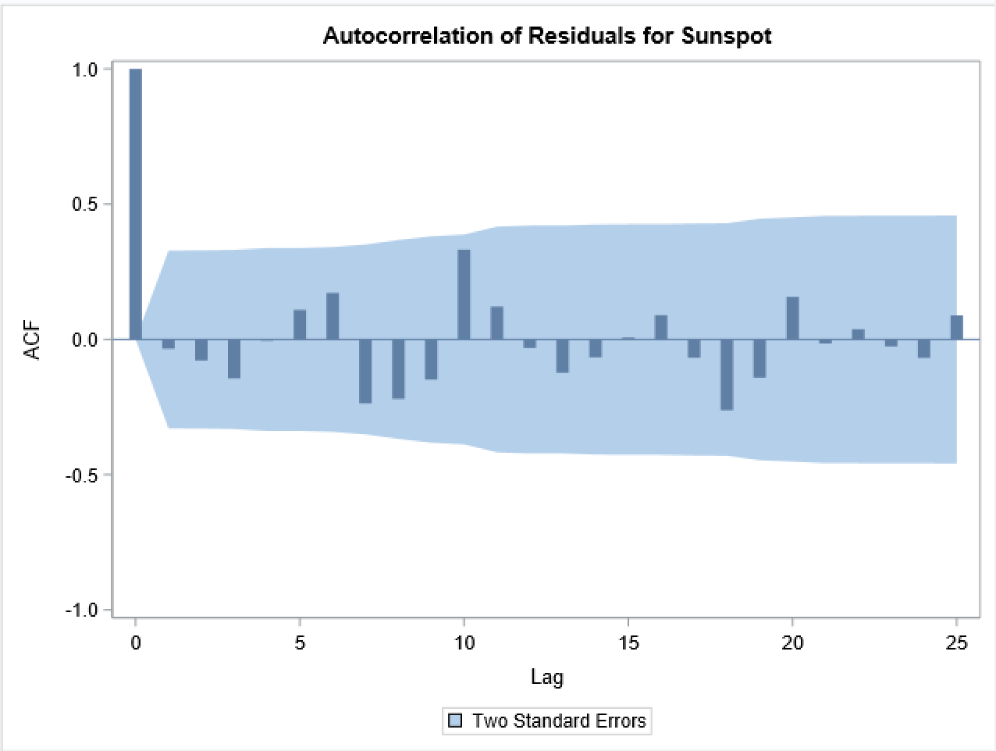
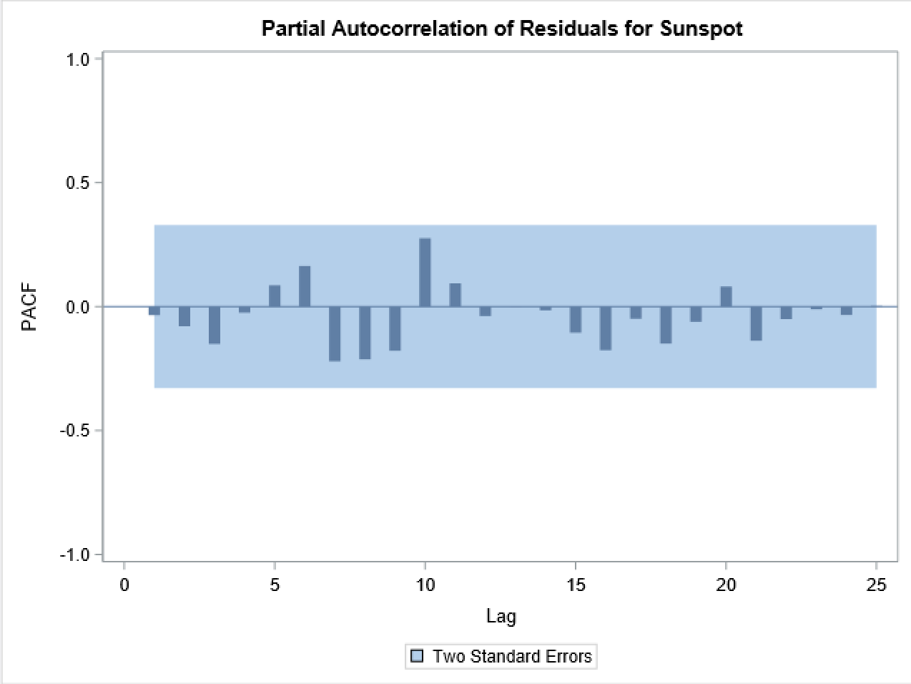
Question 1, Fitting AR(1) ,AR(2), AR(3), and AR(4) Mod
AR(4)
There is evidence of exponential decay-indicates a negative autocorrelation coefficient
In the PCF, this tells us what the order of the model might be
There is a small bar at partial autocorrelation function for lag 1.
This value seems very small, and closely matches the bars in the blue area which tells us the area that statistically these autocorrelations are zero (Not real correlations, not good enough for the model).
AIC: 355.489
AR(4) has the lowest AIC of 355.489

Slide 7
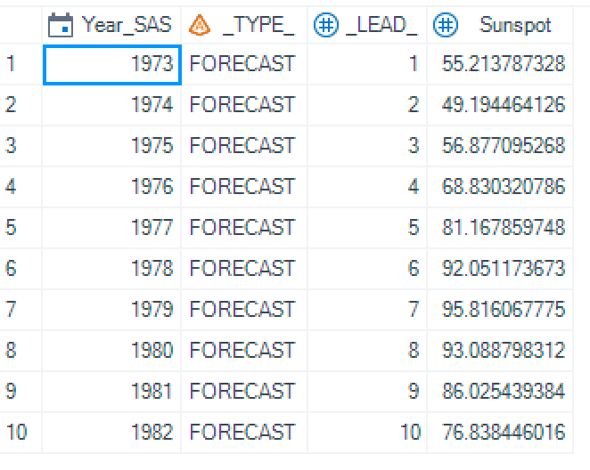
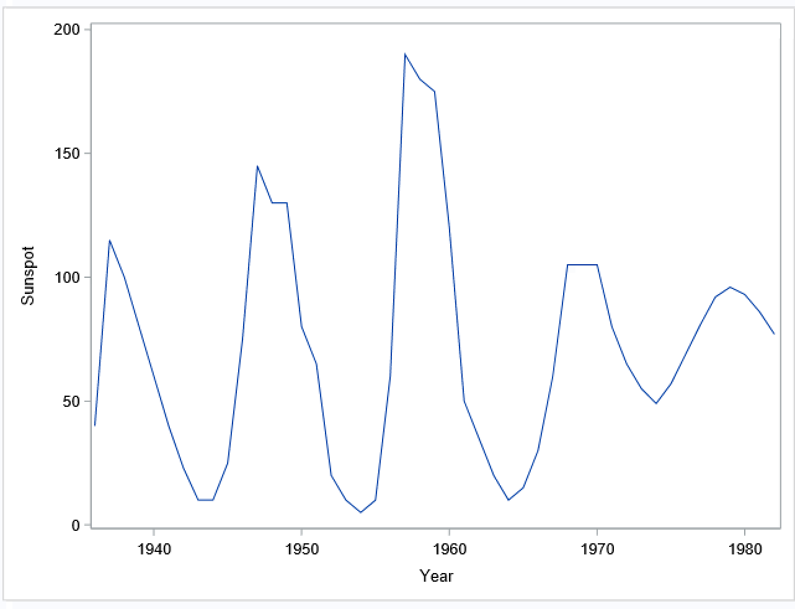
Question 1, 10 year predictions

Slide 8
Question 2
2
4
1
3

